Slide 1
Intro to Vue.js
Build a Doggo Faving Web App

Slide 2
Single Page Applications
What makes a website a web app?
Notes:
As you’ve hopefully started to see from our previous lessons, HTML, JS and CSS can be used to make some very cool, and often complex sites. #
We’re no longer constrained to static text and images, we can make games and apps and tools and all kinds.
The portfolio that we made is clearly a website, but what is a Web App?
While there is no strict definition of the difference between a “website” and a “web app”, it’s probably easy to understand like this:
Websites that you visit and read or consume content on without *interacting* with, or creating content of your own, are websites.
While web apps - web applications - tend to be highly interactive, require you to input data or otherwise change some kind of state in the application.
The lines between the two often blur - would you consider a magazine website where you can leave a comment a “web application”? - probably not, despite it being interactive, and often the distinction between the two things is fairly moot.
Websites tend to either require little interaction, or high levels of interaction, whereas web apps requires complex user interactions.
The logic which controls these interactions is often achieved in the browser, rather than running on the web server.
There is absolutely nothing wrong with your web application logic running on your web server, but applications designed in that way are often more expensive to scale and they require more powerful servers to run the logic, as the application attracts more users.
Conversely, by allowing more logic to run in the users browser, web applications can often just be built against smaller APIs on the server, with the client side doing much of this heavy lifting.

Slide 3
What makes a website a web app?
Increased user interaction
Single Page Applications use APIs to save data
Feel more responsive to users
Notes:
Traditional server side websites tend to be split up into multiple “pages”,
users interact with pages, posting data to the server, which processes that data, and returns a page back to the user.
Even the fastest server rendered web apps will incur a “time cost” of sending full pages of data to and from the browser,
and while this is happening and the page is reloading, the user can’t interact with the application.
Over the last half decade or so, there has been a trend towards most of the application being sent to the browser in one go,
Where the data exchanged with the server is pushed entirely over APIs (like the one in our TODO app).
The benefit of this, is that the users browser never “unloads” the page and has to wait,
so the user can continue browsing and interacting with the application as data is loaded in the background.
Applications built this way are called “Single Page Applications”, because all of their logic lives within a single web page, which manages its own state and fetches its own data,
rather than regular Web Applications which are required to “post back” to the server every time something happens.
Single Page Applications are usually built using popular web frameworks like React.js or Vue.js - which we’ll look at in a few weeks time - but over the next handful of sessions, we’re going to go through some of the concepts that all single page web applications are built around, regardless of which front end framework you choose to use.
In this lesson, we're going to lay out the foundations to create an app like instagram or tinder, which has a UI that changes often without redirecting the user to a new page.

Slide 4
Frameworks and Libraries
Is there code out there that can help to make it less complicated?
Notes:
To solve the problem of constantly having to re-work and re-write the same logic, people build libraries and frameworks with reusable code in them, which will do some of these common things.
Generally, a framework provides you with a whole programming model.
It is the code that controls the execution of your app, and you write code that the framework calls.
Your code must be based on the conventions and rules that the framework sets out.
Libraries, by contrast, are less opinionated. They tend to do one and only one thing.
They can be plugged into your code, regardless of framework you’re using, or even if you’re not using one at all.
Frameworks “constrain” your software architecture - while they *do* allow you to do common things very quickly, if you ever want to do something the framework doesn’t support, it’s often considerably more work.
Libraries, on the other hand, don’t immediately provide you with a working application, but you can build on top of them to do whatever you like.
Most modern web applications tend to be built on top of common frameworks - simply because most web apps tend to do very similar things (use templates or views, load data from APIs, do data binding, do routing). This means that you’ll see lots of applications that look very similar in the real world.
There are two big players in “frontend frameworks” and a handful of other competitors - React leads the pack by a healthy margin but is quite “big”, it’s a lot of code and a lot of dependencies, while Vue, comfortably second place, is often celebrated for being smaller, more lightweight, and simpler to get started with.

Slide 5
Vue is a progressive framework for building user interfaces.
Unlike other monolithic frameworks, Vue is designed from the ground up to be incrementally adoptable. The core library is focused on the view layer only, and is easy to pick up and integrate with other libraries or existing projects. On the other hand, Vue is also perfectly capable of powering sophisticated Single-Page Applications when used in combination with modern tooling and supporting libraries.
Notes:
Vue is a lightweight framework that is frequently used to build single page applications.
It’s a JavaScript library that you include in your HTML, just like any other script file, and it provides a programming model, and a set of built in functions to do the common things that you might want to do in single page applications.
In our banking application, we used HTML templates and built JavaScript code to conditionally load them depending on what our users were doing, Vue offers it’s own way to conditionally render pieces of HTML, and bind data into them.
The other super cool thing that Vue does, is let you use “Observable properties” - what this means, is that you can declare variables in your javascript code, and whenever you update them anywhere where they exist in your HTML will automatically update!
This means that you can build applications with a lot less code, and updating your UI is often as simple as just setting a variable in your code.

Slide 6
The Littlest Vue app
<head>
<script src="https://cdn.jsdelivr.net/npm/vue/dist/vue.js"></script>
</head>
<body>
<div id="app">
Counter: {{ counter }}
</div>
<script>
var app = new Vue({
el: '#app',
data: { counter: 0 }
});
setInterval(() => {
app.counter++;
}, 300);
</script>
</body>
Notes:
The simplest Vue app.
https://glitch.com/edit/#!/the-littlest-vue
This is a tiny Vue app to help explain some of the basic Vue concepts.
First, we’re including the Vue.js library from a CDN
We’re then creating a div to contain our Vue.js application, and we’re doing two important things
Giving the div an ID we can use later
Using Vue’s binding syntax of {{ property-name }}

Slide 7
The Littlest Vue app
<head>
<script src="https://cdn.jsdelivr.net/npm/vue/dist/vue.js"></script>
</head>
<body>
<div id="app">
Counter: {{ counter }}
</div>
<script>
var app = new Vue({
el: '#app',
data: { counter: 0 }
});
setInterval(() => {
app.counter++;
}, 300);
</script>
</body>
Notes:
Then, in our script block, we’re using the code that the vue.js file gives us
We create a new variable “app”, which is an instance of the Vue object.
We pass to that object some configuration that tells Vue where we want it to render.
In this example we set the property “el” to #app - the id selector of the div we created.
We then define the Vue “data” property - this is an object, and any variables we define in here can be used in data binding.
They are turned into “observable properties” which means anytime we change those properties, Vue will automatically update the HTML it renders.

Slide 8
The Littlest Vue app
<head>
<script src="https://cdn.jsdelivr.net/npm/vue/dist/vue.js"></script>
</head>
<body>
<div id="app">
Counter: {{ counter }}
</div>
<script>
var app = new Vue({
el: '#app',
data: { counter: 0 }
});
setInterval(() => {
app.counter++;
}, 300);
</script>
</body>
Notes:
Finally, for the sake of this example, we’re using a timer setup using setInterval - this calls our arrow function every 300 milliseconds.
Every time our interval is called, we’re adding one to our vue apps counter property.
If you look at this example
https://glitch.com/edit/#!/the-littlest-vue
You’ll see that the counter updates on the screen without us having to specifically make it re-render.
This is where a lot of the power of vue comes from - you can, with a small amount of code, make interfaces that react to data that changes.
Vue is an excellent choice for small applications that render data that they receive from APIs. You can download the latest server state, and just have Vue bind whatever JSON you receive right into your UI by updating its data properties, and as you can see here, it requires very little code to get there.
There’s more to Vue than this - it provides a nice way to wire up button clicks and get data from forms, along with clever ways that you can write if statements in your HTML so your app only displays certain pieces of HTML when conditions are met, and through this session, we’re going to explore some of these capabilities.
Vue also contains its own template system called “Vue Components” - and the authors of Vue recommend you split your application up into Components that do one distinct thing each, and then bind data into your components. Doing this makes your codebase easier to reason about. You can easily read the small pieces of code that the component is concerned with without having to understand the entire application all at once.

Slide 9
Vue.js Templates
<div id="app">
Counter: {{ counter }}
<p v-if="counter % 2 === 0">Even Number!</p>
<p v-else>Odd Number</p>
</div>
<script>
var app = new Vue({
el: '#app',
data: { counter: 0 }
});
setInterval(() => {
app.counter++;
}, 300);
</script>
Notes:
We’re going to expand that sample to see how Vue.js template syntax works now.
Here we’ve added an if-else statement to our markup, that checks if our counter is odd or even.
It does this by taking the counter, and using the modulus operator - the percent sign, that returns the remainder of counter divided by 2.
If the remainder is a 0, we know it’s an even number.
So here you can see a few quite sophisticated things happening
We have an v-if statement with a condition in it - exactly the same kind of condition you’ll find in any regular JavaScript code
We also have a v-else statement, on our following element.
You can use v-if, v-else, just like you would in regular code, and when you change Observable data properties in your vue app, the UI will respond.
These v-if and v-else statements are called vue directives.
You can play with this sample here - https://glitch.com/edit/#!/vue-if-else
Now it’s time to build something fun! Dogstagram!

Slide 10
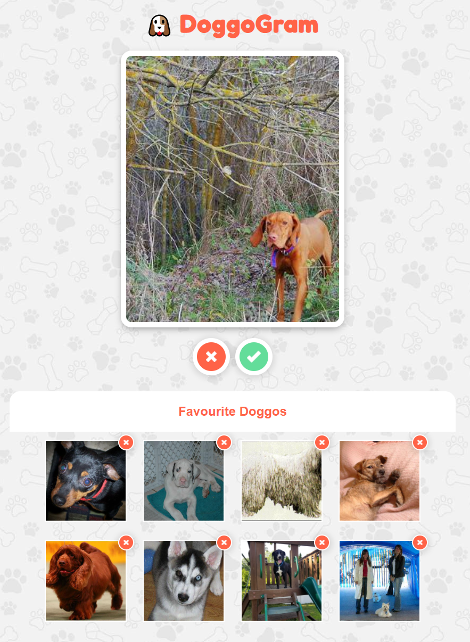
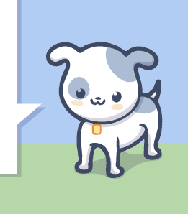
DoggoGram!
Notes:
Starter: https://glitch.com/edit/#!/fef-doggoram-starter
Complete: https://glitch.com/edit/#!/fef-doggoram
We’re going to build Tinder for Doggos!
What it does
Uses a dog API to query dogs
When the page loads, should load a fresh dog
Can add dogs to favourites

Slide 11
An empty Vue App
<head>
<title>The Goodest Vue App</title>
<script src="https://cdn.jsdelivr.net/npm/vue/dist/vue.js"></script>
</head>
<body>
<div id="app"></div>
<script>
const app = new Vue({
el: '#app',
data: {}
});
</script>
</body>
Notes:
We’re going to start here with this empty Vue app. It’s using Vue from the CDN and has an empty div and a vue app with no data properties and we’ll build up our application from there.

Slide 12
Extracting our JavaScript
<head>
<title>The Goodest Vue App</title>
<script src="https://cdn.jsdelivr.net/npm/vue/dist/vue.js"></script>
<script src="script.js" defer></script>
</head>
<body>
<div id="app"></div>
</body>
Notes:
Because it’s a good idea to split out our JavaScript from our Vue code, we’re going to move the contents of our script element to a new file called index.js
Let’s add a script tag to the head of our document referencing script.js - you’ll need to create this file if you don’t already have one.

Slide 13
script.js
/* global Vue */
const app = new Vue({
el: '#app',
data: {}
});
Notes:
We’re going to put our new Vue app inside of script.js.
We’re adding a comment to the top of the file /* global Vue */ which tells the js-hint tool that runs inside glitch that the library “Vue” is declared and referenced elsewhere (in our HTML) which will stop glitch telling us that we have errors in our code.

Slide 14
Vue Methods
const app = new Vue({
el: "#app",
data: {},
methods: {
helloWorld: function () {
console.log("Hello World!");
},
},
});
Notes:
Much like we can add data to our vue application, we can also add methods to the Vue configuration object.
The “methods” property on the vue configuration object is just an object that contains a bunch of properties - and each one should be a function like in our example here.
You can add as many functions as you like into your vue methods object here - but as your application grows, you’ll probably end up splitting these out into their own components.
We’re defining a function, but it’s never getting called.
Let’s fix that.

Slide 15
Vue lifecycle hooks - created()
const app = new Vue({
el: '#app',
data: {},
methods: {
helloWorld: function () {
console.log("Hello World!");
}
},
created() {
this.helloWorld();
}
});
Notes:
Hooks are functions that get called at different times in your “application life-cycle” - that’s a very technical way of saying “when certain things happen in your app”.
Lifecycle hooks supported by default are:
beforeCreate
created
beforeMount
mounted
beforeUpdate
updated
activated
deactivated
beforeUnmount
unmounted
errorCaptured
renderTracked
renderTriggered
We’re going to add a created lifecycle hook here to get a new dog when our app loads.
By adding a function which has the same name as the part of the Vue lifecycle you want to “hook”, you can have code that runs on those events.
We’re going to add a hook called created - which will run when the application is created so we can start loading our dogs.
Our Hello World function will now be called when the page loads.
This code should now log Hello World into your console (along with some Vue debug messages) - which is great, but we really want to get some dogs :)

Slide 16
The Dog API
Using - https://dog.ceo/dog-api/
Doing a GET (a…. fetch?.... lol ) of https://dog.ceo/api/breeds/image/random
Returns:
{
"message": "https://images.dog.ceo/breeds/pug/n020.jpg",
"status": "success"
}
Notes:
We’re going to use dog.ceo - the internets biggest collection of open source dog pictures.
They provide an API, that when called, returns a random dog image URL.
We’re going to take our newfound knowledge of this most valuable of public APIs to use our browsers fetch API to load a dog when our application starts up.

Slide 17
“Fetch”-ing a Good Boy
const app = new Vue({
el: "#app",
data: {
currentDogUrl: null,
},
methods: {
loadDog: async function () {
const response = await fetch("https://dog.ceo/api/breeds/image/random");
const asJson = await response.json();
this.currentDogUrl = asJson.message;
console.log(this.currentDogUrl);
},
},
created() {
this.loadDog();
},
});
Notes:
First, we’re adding a null property to our Vue “data” object - called currentDogUrl.
We need to add it, and initialize it to a null, so that Vue knows to track changes to that property.
Next, after removing our helloWorld function, we’re adding a new async function called loadDog.
We’ve used async/await and fetch in a couple of our previous exercises, and this works the same way.
We’re using the browsers fetch api to call the Dog API - it defaults to doing a HTTP GET.
Once we have the result, we’re awaiting response.json() to read the data the API sends us, and convert it to a json object.
As we saw on the previous slide, the response should have a single “message” property with the URL of a random dog, so we’re grabbing that from our asJson variable, and assigning it to this.currentDogUrl that we just created in our data object.
Finally, we’re editing the created hook so we now call loadDog instead of our (now deleted) helloWorld function.
If you take a look in your browser console now, you should see a URL get logged when the page loads!

Slide 18
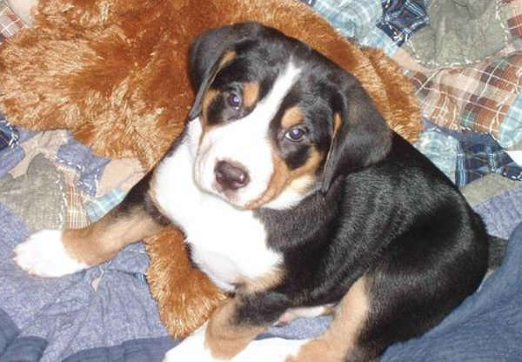
Displaying an image with the v-bind directive
<div id="app">
<img v-bind:src="currentDogUrl" alt="A Good Boy" />
</div>
<div id="app">
<img :src="currentDogUrl" alt="A Good Boy" />
</div>
Notes:
We can render text with {{ curly brace notation }} like we saw at the start of the session.
But to render images, we’ll need to BIND our dogs image URL to an img element in our code.
Because Vue is doing all the hard work for us now, all we have to do add a Vue bind attribute to our markup to “bind” our dog url into an image element.
The syntax for that is v- hyphen - bind, colon, then the name of the regular HTML attribute you want to bind the data to, in this case, the src attribute of our image. We’ve also added an alt tag here for good measure.
Now when the page loads, you should see a dog! *
You can see how compared to writing all the code to load templates and create elements ourselves, this is a really nice way to productively build web apps without having to write all the “glue” code ourselves.
There’s even a shorter form of the v-bind syntax, where all you need to do is prefix the name of the attribute you’d like to set with a colon, like our second example here.
* *

Slide 19
Adding a “Next” button
<div id="app">
<img :src="currentDogUrl" alt="A Good Boy" /><br />
<button @click="loadDog">Next</button>
</div>
Note:
@click="loadDog" is shorthand for v-on:click="loadDog"
Notes:
Because Vue is observing our currentDogUrl property, loading a new dog just involves calling the loadDog function again.
Vue lets you easily wire up event handlers by using the @ prefix, followed by the event name - in this case, we’re adding a button and then setting the attribute @click to our function loadDog.
Under the hood, Vue will add an event listener to the click event of your button, and call loadDog.
Just like :src is a shorthand for v-bind:src, @click is shorthand for v-on:click
Vue expects that your click handlers are part of the Vue methods object.

Slide 20
Create a favourites list
const app = new Vue({
el: '#app',
data: {
currentDogUrl: null,
favourites: []
},
methods: {
loadDog: async function () {...},
addFave: function () {...}
},
created() {...}
});
Notes:
We’re now going to add a list to our observable data object for our favourite dogs.
Add a property called “favourites” to our data object and add a new function called addFave to our methods.

Slide 21
Display fav button and fav list
<div id="app">
<img :src="currentDogUrl" alt="A Good Boy" />
<button @click="loadDog">Next</button>
<button @click="addFave">Fave</button>
<ul>
<li v-for="dog in favourites">
{{ dog }}
</li>
</ul>
</div>
Notes:
We’re also going to first add a new button that calls our new addFave function - even though it doesn’t do anything yet.
We’re also going to use the v-for directive to write a for loop over each of the dogs
We’re creating a UL unordered list element, then creating an li, with the v-for directive attributes present.
The v-for directive will create a new LI element for each dog in our data.favourites property.
We’re just using the {{ dog }} template syntax here - so whatever we put in the list will just be printed on the screen.

Slide 22
Create a favourites list - add logic
methods: {
loadDog: async function() {...},
addFave: function() {
this.favourites.push(this.currentDogUrl);
}
}
Notes:
Now we’re going to write the code to add favourite dogs to our list.
This is remarkably simple using Vue - we just push this.currentDogUrl into our this.favourites list - which will start off as an empty array.
The only problem here is that a user could add multiple copies of the same dog to their favourites list - so to stop it, we’ll add a guard clause...

Slide 23
Create a favourites list - add logic
methods: {
loadDog: async function() {...},
addFave: function() {
if (!this.favourites.includes(this.currentDogUrl)) {
this.favourites.push(this.currentDogUrl);
}
this.loadDog();
}
}
Notes:
We can use the array method “includes” to check if the currentDogUrl is already in the list before we add it.
Our code here says - “if this.favourites does not include this.currentDogUrl, add it to the list”
We’re finishing off by calling loadDog, so once you favourite a dog, a new dog is shown.
Test it out
Our Next and Fave buttons now work, but we want to display our favourites, rather than just listing their urls.

Slide 24
Displaying Your favourite dogs as images
<div id="app" class="app">
<h1 class="title">🐶 Dogstagram</h1>
<img :src="currentDogUrl" alt="A Good Boy">
<button @click="loadDog">Next</button>
<button @click="addFave">Fave</button>
<section>
<h2>Favourite Doggos</h2>
<ul>
<li v-for="dog in favourites">
<img :src="dog" />
</li>
</ul>
</section>
</div>
Notes:
By switching out the text in our list item for an image tag, we can display our favourite dogs as their actual images rather than just text.
We’re going to need to style this list item a little bit more thoroughly to have it appear as a set of favourite cards, but you can see the code working here already.

Slide 25
Remove from Favourites Button
<div id="app" class="app">
<h1 class="title">🐶 Dogstagram</h1>
<img :src="currentDogUrl" alt="A Good Boy">
<button @click="loadDog">Next</button>
<button @click="addFave">Fave</button>
<section>
<h2>Favourite Doggos</h2>
<ul>
<li v-for="dog in favourites">
<img :src="dog" />
<button @click="removeFave(dog)">Remove</button>
</li>
</ul>
</section>
</div>
Notes:
We add a new button, with the @click handler calling a new function called removeFave, passing dog as the argument.
Our output will now render the remove button, but we’re going to have to add another function to our methods to make this work.

Slide 26
Remove from Favourites Button
methods: {
loadDog: async function() { … },
addFave: function() { … },
removeFave: function(dog) {
this.favourites = this.favourites.filter(item => item !== dog);
}
}
Notes:
We add a new button, with the @click handler calling a new function called removeFave, passing dog as the argument.
Our output will now render the remove button, but we’re going to have to add another function to our methods to make this work.

Slide 27
Let’s add some styles
<div id="app" class="app">
<h1 class="title">🐶 DoggoGram</h1>
<img :src="currentDogUrl" alt="A Good Boy" class="card"/>
<button @click="loadDog" class="nope">Next</button>
<button @click="addFave" class="fav">Fave</button>
<section class="favourites">
<h2>Favourite Doggos</h2>
<ul class="favourites-list">
<li v-for="dog in favourites" class="favourites-item">
<img :src="dog" class="favourites-img" />
<button @click="removeFave(dog)" class="remove">Remove</button>
</li>
</ul>
</section>
</div>
Notes:
First we’ll add some classes to the html that we can select to add styles to

Slide 28

Grid template areas
body {
margin: 0;
font-family: arial;
background: url(url.goes.here) #f2f2f2;
}
.app {
display: grid;
grid-template-columns: 1fr 1fr;
grid-template-rows: auto 520px 120px 1fr;
grid-template-areas:
"title title"
"card card"
"nope fav"
"favourites favourites";
height: 100vh;
}
Title
Card with dog photos
Favourites section
Next Fav
Notes:
We’ll make the layout of the app with grid template areas, which we’ve not looked at yet.
These are a nice way to easily visualise the layout of your app in the css, our layout will look like this
+-----------------------------+
| |
| heading |
+-----------------------------+
| |
| dog card |
+--------------+--------------+
| | |
| Next | Fav |
+--------------+--------------+
| |
| Favourites |
+-----------------------------+
We can use the grid template areas property to lay out how each “area” will span each column
Then when we style the areas themselves we use the grid-area property to name it like so:
https://cdn.glitch.com/8c995165-2303-4457-a458-2b353ff3e9a1%2Fbg.jpg?v=1633185706738

Slide 29
Grid template areas
.title {
grid-area: title;
margin: .5em;
text-align: center;
color: tomato;
}
.card {
grid-area: card;
display: block;
width: 100%;
max-width: 400px;
height: 500px;
margin: auto;
border-radius: 10px;
outline: 10px solid white;
object-fit: cover;
overflow: hidden;
background-color: white;
box-shadow: 0px 5px 15px 5px rgba(0, 0, 0, 0.5);
}
Grid area name,
to reference in
grid-template-areas
Notes:
As you can see here, the grid-area property matches up with the grid template areas that we just marked out.
Then we have some other styles to set the height and width of the image, to make sure it doesn’t get too tall or wide, and we round off the corners because it looks nice

Slide 30
Google fonts
.title {
grid-area: title;
margin: .5em;
font-size: clamp(40px, 5vw, 3rem);
font-family: 'Fredoka One', cursive;
letter-spacing: 1px;
text-align: center;
color: tomato;
}
https://fonts.google.com/specimen/Fredoka+One
Notes:
Then we’re going to apply a google font, which are special hosted fonts provided by google for free
They are great when you want a fancy font that is more exciting than the ones that are usually considered web safe, but use sparingly, each font you add means extra data downloaded for your user, which will not only make your site slower but could cost them more money if they’re paying for data.
https://fonts.google.com/specimen/Fredoka+One

Slide 31
Buttons
button {
width: 70px;
height: 70px;
margin: 20px 5px;
border: 8px solid white;
border-radius: 50%;
color: transparent;
cursor: pointer;
box-shadow: 0 2px 10px 5px rgba(0, 0, 0, 0.1);
}
Notes:
We’ll make some generic styles for buttons that will apply to the next, fav and delete buttons
We’ve give them a width and a height and a 50% border radius to make them round, a nice white border and set cursor to pointer to get the little hand instead of the arrow cursor.

Slide 32
Buttons
.nope {
grid-area: nope;
background: url('https://urlgoeshere.com') tomato center no-repeat;
background-size: 20px;
justify-self: end;
}
.nope:hover,
.remove:hover {
background-color: #da553d;
}
.fav {
grid-area: fav;
background: url('https://urlgoeshere.com') no-repeat center #63dd9a;
background-size: 26px;
}
.fav:hover {
background-color: #51c384;
}
Notes:
Then we’ll style the individual buttons, nope, which takes us to the next doggo and fav which adds it to our favourites,
We’ll give them red and green background colours and a background image of a cross or a tick. URLS for each of the images are below:
https://cdn.glitch.com/381dc777-702c-41b2-82aa-cac2e30d38de%2Funchecked.png?1522935023612
https://cdn.glitch.com/381dc777-702c-41b2-82aa-cac2e30d38de%2Fchecked%20(1).png?1522935023792

Slide 33
Favourites section
h2 {
position: sticky;
top: 0;
margin: 0 2rem;
padding: 1em;
border-top-left-radius: 20px;
border-top-right-radius: 20px;
text-align: center;
color: tomato;
background-color: white;
z-index: 1;
}
.favourites {
grid-area: favourites;
overflow-y: auto;
}
Notes:
We’ll style the favourites section next, so the header can be our nice tomato colour and centered
And we want the section to get a scroll bar if we add so many favourites that they overflow the area.

Slide 34
Favourites section
.favourites-list {
display: flex;
flex-wrap: wrap;
align-items: center;
justify-content: center;
padding: 0;
margin: 0;
}
.favourites-item {
position: relative;
list-style: none;
margin: 15px;
}
.favourites-img {
width: 150px;
height: 150px;
object-fit: cover;
border: 2px solid white;
}
Notes:
We want the unordered list items to sit next to each other, not in a single column, so we set the ul to display flex.
We want it to wrap, and have the items aligned and justified center. The ul has margin and padding by default, so we’ll set those to zero.
Then the favourites item is going to contain the favourite image and the delete button, we want the delete button to sit on the bottom right hand corner of the image so we set the container to be position relative, and in a second we’ll set the delete button to position absolute, within that relative parent.
We hide the bullet points on the li with list-style none and add some margin so that they have some space between each favourite
The the image we’ll set a specified width and height of 150px and object fit: cover will make sure that the aspect ratio of the image doesn’t stretch or squish.

Slide 35
Favourites section
.remove {
position: absolute;
top: -10px;
right: -14px;
height: 30px;
width: 30px;
margin: 0;
border: 2px solid white;
background: url('https://yoururlhere.com/png') tomato center no-repeat;
background-size: 10px;
}
Notes:
And finally we will style up the delete button.
Its going to be position absolute so we can move it to the bottom right of the image
And we’ll set its height and width and remove any margin that was on the button
Make the border smaller
Set the same background image as the one on the next button, but make it smaller with background size
Here’s the url for that background image again:
https://cdn.glitch.com/381dc777-702c-41b2-82aa-cac2e30d38de%2Funchecked.png?1522935023612

Slide 36
Using localStorage to remember our faves!
created() {
this.loadDog();
},
mounted() {
if (localStorage.favourites) {
this.favourites = JSON.parse(localStorage.favourites);
}
},
Notes:
We’ve used the localStorage API before, but we can add it to Vue to make sure that we save our list of favourites between visits to Woofstagram.
We need to use a new view lifecycle function called “mounted” - which run when view first renders our application.
Here we check if localstorage contains a key called “favourites”, and if it does, we’re going to assign this.favourites to the parsed JSON from storage.
This is great, but it’s always going to be empty for the moment.

Slide 37
Using localStorage to remember our faves!
created() {
this.loadDog();
},
mounted() {
if (localStorage.favourites) {
this.favourites = JSON.parse(localStorage.favourites);
}
},
watch: {
favourites(updatedFavourites) {
localStorage.favourites = JSON.stringify(updatedFavourites);
}
}
Notes:
Because our favourites array is a vue data property, we can add a vue watch onto it.
To add a watch in vue, we need to add the watch object to our app, and create a function where the function name matches the name of the property we watch to watch.
Whenever that property changes, our function will be called with the latest value passed as an argument.
In this case, we’re going to add a function called favourites, and we’ll call the updated values “updatedFavourites”.
We’re then going to use JSON stringify to take a copy of our favourites and put them in local storage, ready to be loaded on the next page refresh!
It’s pretty awesome that Vue lets us do this so simply.

Slide 38
Further work
Can you add some styles to make the card slide out if you press next?
Take it and make it your own! Change the colours, change the API, make it yours!
Add a favicon + some OG data for social media
Notes:
Check out https://glitch.com/edit/#!/biscuittin-der for animation inspiration
You could find a different api, maybe one with cats! And update the app to show something new!
Add a favicon: check out https://www.lcn.com/blog/beginners-guide-favicons/ for info on how to add a favicon
Here’s some helpful info on adding OG data:
https://www.freecodecamp.org/news/what-is-open-graph-and-how-can-i-use-it-for-my-website/

Slide 39

Let’s make a PWA!
Notes:
As developers, as business owners, as people who have a product, service or brand
We want other people to use the thing we’re building, we want their interaction with our products to be pleasant and easy and we want them to feel engaged.
Engaged enough to want to continue to use these products
We want people to be able to find our content easily, the easier it is to find, the more users you’re going to reach
We want people to save our content and take it with them, have it at the end of their fingertips whenever they want it
and that means that we’re asking them to download something.
Depending on what country they’re in and what kind of contract they’re on we’re also asking our users to spend, often not insignificant amounts of money to find, download and use our products.
The tool that many companies are employing to help them in this quest for engagement and discoverability is an app
Apps give us a way to present a reliable and slick user experience without interruptions or distractions, there is no browser UI or unrelated content, just the stuff that we want them to see.
And Apps can offer an ‘offline experience’ to users when their wifi is down.

Slide 40
What is a PWA?
‘App like experience’ but built in HTML, CSS and JS
Able to ‘save to home screen’ with an icon
Offers an offline experience (not just an uh oh page)
Notes:
Progressive web apps can give us the reach of the web and the stickyness of an app. They act like a website when browsed to on a desktop, but on a mobile they allow us to remove the browser chrome entirely. Creating an ‘app like’ experience. They will also offer a prompt to the user to ‘save to home screen’ which will add an icon to their home screen so that they can easily get back to your app without needing to open a browser
Through the use of something called a ‘service worker’ which we’ll look at in a bit, they let us offer ‘offline functionality’.
When chrome first introduced the dinosaur game to replace the ‘you are offline’ page a lot of users were really confused because they didn’t realise what it was.
PWAs let you offer your users data stored in local storage, or a nicely styled page which matches our app style letting them know they’re offline.
So, lets turn this web app that we’ve made into a PWA.

Slide 41
What is a PWA?
Web App Manifest
Icons
Service Worker
Notes:
In order to make a web app into a progressive web app, we’ll need to add some configuration called a manifest file, and some icons, that work like a favicon does, which will show on the homescreen when you save your app to homescreen
Then we’ll add a service worker
And we have to make sure that our app is served over https, which it is, because we’re using glitch.

Slide 42
Manifest file
JSON file
Provides metadata about an application
Contains settings for the app like experience of your PWA
Notes:
The manifest is what allows your users to download your web app to the homescreen of their device
Creating a manifest and linking it to your page are straightforward processes, just like you’d link your css, except the rel attribute will say manifest rather than stylesheet
You can call the manifest whatever you want. Most people use manifest.json.
It holds metadata about your app which will define how you want the app to display
The best way to understand this is to look at some code
So, lets take a look at one

Slide 43
manifest.json
{
"background_color": "#ffffff",
"description": "Choose your favourite dogs",
"display": "standalone",
"name": "Dogstagram",
"orientation": "any",
"scope": "/",
"short_name": "Dogstagram",
"start_url": "/",
"theme_color": "#ff6346",
"icons": [
{
"src": "https://url.of.icon.com/icon.png",
"type": "image/png"
}
]
}
Notes:
A web app manifest contains metadata about your app which will define how you want the app to display. For example
A name for use in the Web App Install banner
A short_name for use as the text on the users home screen.
A start URL which will define how your app is launched,
If you add a query string parameter to the start_url you can indicate how your PWA will be launched and send your users right to where they want to be
Set an icon which will show on the homescreen, you can set this as an array of images of different sizes. You need to give at least the 192 and 512.
When your PWA opens, the browser will show a splash screen with the icon image and a title that is the "name".
The background colour of the splash screen will be whatever colour you set as a background_color
You can also set a theme color which sets the color of the browser toolbar.
Hide the browser’s UI by setting the display type to standalone instead of minimal ui
Change the page orientation, landscape or portrait.
This info needs to presented in a specific way, we're going to use a generator to do the formatting for us.
https://www.pwabuilder.com/
You can either go to https://www.pwabuilder.com/ and start filling in info about your site,
Or write your own manifest from scratch.
don't forgot to give it your icon.
When picking a display mode, standalone is the most native app like, feel to to experiment and test out the differences between all the options.
https://cdn.glitch.com/8e5bb503-a352-40bd-87bd-d96bac58b9b0%2Ffavicon.ico?v=1623071189790

Slide 44
Offline content with service workers
Add an empty file called /sw.js
Notes:
Service workers essentially act as proxy servers that sit between web applications, the browser, and the network (when available).
What that means is that when your webpage makes a request to get some data - like an image, or a file, the service worker gets the chance to intercept the http request and do something else with it.
They are intended, among other things, to enable the creation of offline experiences, intercept network requests and take appropriate action based on whether the network is available.
To use service workers, we need to add a JavaScript file that we later "register" as a Service Worker.
Let's add an empty sw.js file now that we'll use for our service worker code.

Slide 45
Offline content with service workers
const CACHE = "favouriteImageCache";
self.addEventListener('install', async (event) => {
const cache = await caches.open(CACHE);
await cache.add("/");
await cache.add("/script.js");
await cache.add("/style.css");
});
Notes:
This is the start of our service worker.
Service workers, work, by letting you listen to special service worker events in what is called "the service worker lifecycle" - don't worry too much about the details here - they just work like any other event listeners, like when we're listening to button click events in our normal code.
Service workers offer a few events to listen to, but the two we're going to be paying attention to are the "install" and the "fetch" events.
In our code here, we're adding an event listener to the "install" event - which means when our web app registers the servive worker, this code will get run in the background.
At the top here, we're going to give our cache a name - it doesn't really matter what our cache is called, but because we want to use it to store our favourite images, we're going to call it "favouriteImageCache".
When we register the event listener, we "open" our cache, then we can manually add a few items to the cache - our index.html file (by adding "/" - slash), our script.js file, and our style.css file.
This means that when the service worker is installed, a copy of our files is going to be saved in the users browser.

Slide 46
Offline content with service workers
self.addEventListener('fetch', (event) => {
event.respondWith((async () => {
try {
return await fetch(event.request);
} catch (error) {
const cache = await caches.open(CACHE);
return await cache.match(event.request);
}
})());
});
Notes:
Next, we're going to add an event listener to the "fetch" event - this will get called whenever our browser tries to load anything over HTTP.
We're going to do the simplest thing that can possibly work here, but first we'll have to explain some syntax.
What you can see here is a try...catch block. What this means, is that if any errors happen between the try open bracket, and the try closing bracket, the code in the catch block will get run.
We're using the service worker event API here - which is a bit complicated to explain - what this code says is, when a fetch event occurs, run the code that's passed as a callback to our "respondWith" function.
respondWith actually expects a function, which returns a function, with some code to run, which is why there are so many brackets EVERYWHERE, but let's not worry too much about that for now.
Our try..catch block here says "when there is a web request, try fetch it" (passing the event.request, the request the browser made) to the regular fetch method and returning its result.
If trying to get the data fails - because we're offline, or the API is down, then in our catch block, we're going to open our cache, and then use the cache.match function passing event.request.
This match function will check our catch, and if we have added an entry for that request, it'll return it.
This means that if we're offline, and our index page tries to load our script.js or style.css file, it'll get returned from the cache just like we're online!

Slide 47
Register the Service Worker
At the very bottom of the script.js file add:
if ('serviceWorker' in navigator) {
navigator.serviceWorker.register('sw.js');
}
Notes:
In order to let the browser know that you want to use a service worker, we're going to have to add this code at the bottom of script.cs - it first checks if the browser supports service workers (they all do, don't worry!), and then it uses the navigator.serviceWorker.register function passing the path of our file sw.js.
This if statement is called "capability detection" - where we're checking if a browser supports a specific feature before using it.

Slide 48
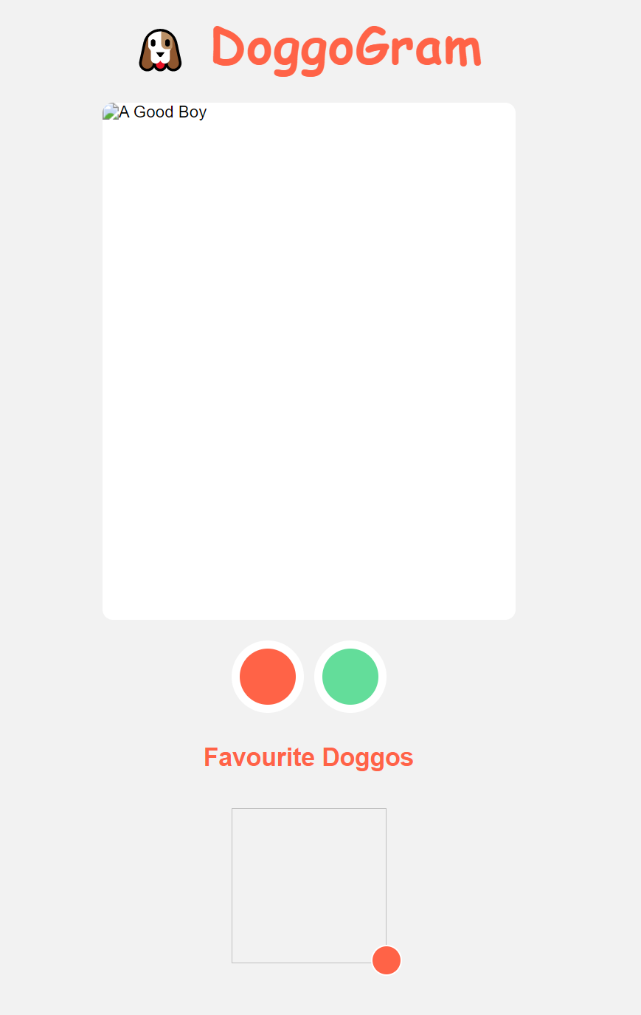
But it doesn’t look right without cached data :(
Notes:
Now when we load our page when it’s offline, our HTML JavaScript and CSS will load, but all our images will be missing!
Not the experience we expected

Slide 49
Add images to cache
addFave: async function() {
if (!this.favourites.includes(this.currentDogUrl)) {
this.favourites.push(this.currentDogUrl);
const imageCache = await caches.open("favouriteImageCache");
imageCache.add(this.currentDogUrl);
}
this.loadDog();
},
Notes:
In our application code, when we’re adding a dog to our favourites, we can open, and add the current dog image to the cache that our service worker reads from.
By doing this, we know that the browser will always have a record of our faves!

Slide 50
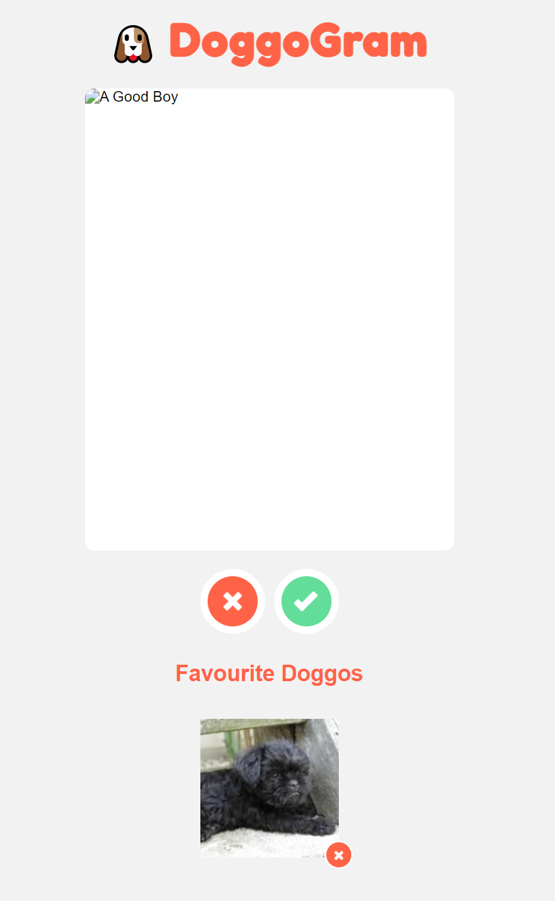
Hiding elements of the page while offline
Notes:
This is better - our faves are now visible while we’re offline, but it’s not a great user experience.
The application still looks broken because of the big space in the middle of the app.
Thankfully our browser has an API that we can use to detect if we are on or offline, and change our UI!

Slide 51
Checking for online in a browser
const onlineStatus = navigator.onLine; // true or false
addEventListener('offline', () => {
this.online = false;
});
addEventListener('online', () => {
this.online = true;
});
Notes:
You can check the property navigator.onLine to check if you’re currently online.
Because this may change at any time (as people walk into underpasses or subways, or go to areas with poor signal), we can also add an event listener to the properties “online” and “offline”;
Let’s work out how to make our Vue UI understand the online / offline state.

Slide 52
Add a Vue data property of online
data: {
currentDogUrl: null,
favourites: [],
online: true,
},

Slide 53
mounted() {
if (localStorage.favourites) {
this.favourites = JSON.parse(localStorage.favourites);
}
this.online = navigator.onLine;
addEventListener('offline', () => { this.online = false; });
addEventListener('online', () => { this.online = true; });
},
Notes:
Add code into our mounted function to set the value of this.online to the current online state.
Then, we’re going to add two event listeners that whenever we go on or offline, will update this.online so our Vue app can use it.

Slide 54
Add a container and the CSS to fix the grid
<div class="container" v-if="online">
<img :src="currentDogUrl" alt="A Good Boy" class="card"/>
<button @click="loadDog" class="nope">Next</button>
<button @click="addFave" class="fav">Fave</button>
</div>
---------------------------------------------------------------------------------
.container {
display: contents;
}
Notes:
Back in our HTML, we’re going to add a container class around our currentDog card, and the next / fave buttons.
You’ll notice we’re using a vue v-if directive here - this directive will show or hide this div - our main dog photo and the buttons, as the online variable gets set.
Display:contents is a really useful CSS property which will make a grid layout ignore a block level elment for its layout and display it as if it were a text element

Slide 55
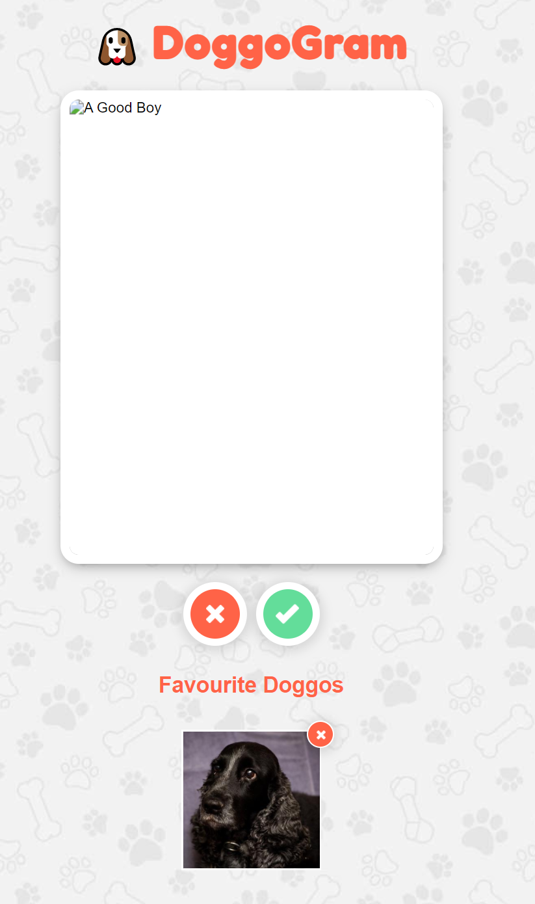
Coming back online
Notes:
We only have one remaining problem.
If we load our app while we’re offline, and then come back online, you’ll notice there’s a broken image as we’ll display the dog photo, but not have anything to put in it.

Slide 56
Coming back online with a watch
watch: {
favourites(updatedFavourites) {
localStorage.favourites = JSON.stringify(updatedFavourites);
},
online(isOnline) {
if (isOnline) {
this.loadDog();
}
}
}
Notes:
To solve this problem we’re going to add an additional watch to our online property.
That way, when the online property changes, if the value of that property is true - we just came online - then we’ll immediately try to load a photo of a new dog, to make sure our users don’t see an empty ui

